Slide 1

Department of Information Technology ABES Engineering College, Ghaziabad, UP
MINI PROJECT PRESENTATION SESSION 2021-22
Name : SHIKHAR AGRAWAL
Class & Section : IT-C
Roll No. : 2000320130154
Admission No : 2020B0131072

Slide 2
Coursera
Coursera Inc is a U.S-based massive open source online course provider founded in 2012 by Stanford University computer science professors Andrew Ng and Daphne Koller.
Coursera is a global online learning platform that offers anyone, anywhere, access to online courses and degrees from leading universities and companies.
Coursera partners with more than 200 leading universities and companies to bring flexible, affordable, job-relevant online learning to individuals and organizations worldwide.
They offer a range of learning opportunities—from hands-on projects and courses to job-ready certificates and degree programs.

Slide 3
Objectives of course :
Training with Python essentials
Python – To understand it as a programming language
Variables and expressions
Conditionals
Functions in python
Loops and iterations

Slide 4
Training overview
Python for Everybody course will introduce fundamental programming concepts including data structures, networked application program interfaces, and databases, using the Python programming language. In the Capstone Project, you’ll use the technologies learned throughout the Specialization to design and create your own applications for data retrieval, processing, and visualization.
Learning from the course:
The basics of the Python programming language.
Use variables to store, retrieve and calculate information.
Utilize core programming tools such as functions and loops.

Slide 5
Presentation
Computer vision
Libraries used
Making
Requisite’s analysis
Code of operation
Output
Vision

Slide 6



Face recognition using Open-CV in Python
-By SHIKHAR AGRAWAL

Slide 7
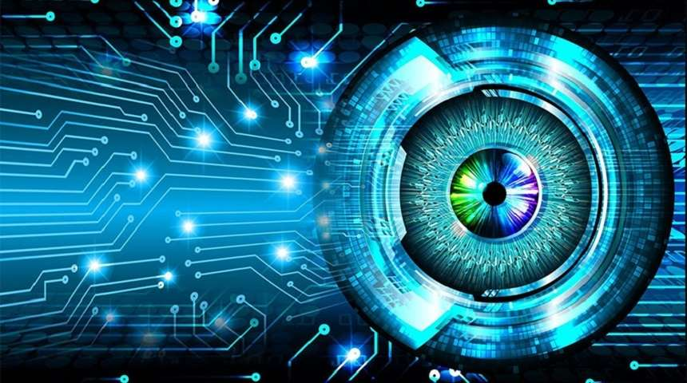
COMPUTER VISION

Slide 8
Computer Vision
Computer vision is a process by which
We can understand the images and videos
How they are stored
How we can manipulate and retrieve data from them
Computer Vision is the base or mostly used for Artificial Intelligence.
Computer-Vision is playing a major role in self-driving cars, robotics as well as in photo correction apps.

Slide 9


Slide 10
OpenCV
OpenCV is the huge open-source library in Python.
It is used in computer vision, machine learning, and image processing.
It plays a major role in real-time operation which is very important in today’s systems.
By using it, one can process images and videos to identify objects, faces, or even handwriting of a human.

Slide 11
Applications of OpenCV
Face/Object recognition
Automated inspection and surveillance
number of people – count (foot traffic in a mall, etc.)
Vehicle counting on highways along with their speeds
Interactive art installations
Defect detection in the manufacturing process (the odd defective products)
Video/image search and retrieval
Robot and driver-less car navigation and control
Medical image analysis
Movies – 3D structure from motion

Slide 12
NumPy
NumPy stands for Numerical Python.
NumPy is a scientific computation package.
It offers many functions and utilities to work with N-Dimension arrays.
It is an open source project and you can use it freely.
It is largely used by other libraries such as OpenCV, TensorFlow to deal with multi-dimensional arrays (e.g., tensors or images).

Slide 13
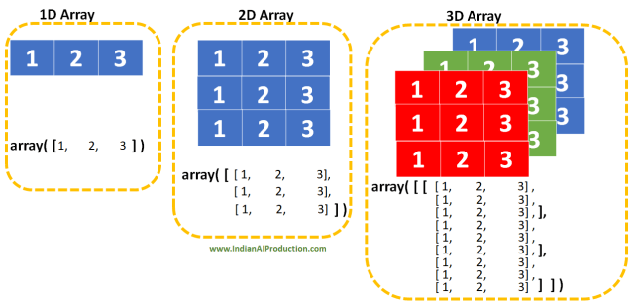

Slide 14
Flow of code
Recognising faces in webcam feed.
Extracting feature from the feed.
Recognising faces in images.

Slide 15
Face Detection
In computer vision, one essential problem we are trying to figure out is to automatically detect objects in an image without human intervention.
The definition of face detection refers to computer technology that is able to identify the presence of people’s faces within digital images.
Face detection can be thought of as such a problem where we detect human faces in an image.
Face detection applications use machine learning and formulas known as algorithms to detecting human faces within larger images.
Face detection is a key element in processing information through images.

Slide 16
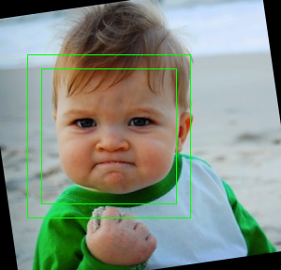
Face detection

Slide 17
Feature Extraction
Now that we have cropped the face out of the image, we extract features from it.
Here we are going to use face embeddings to extract the features out of the face.
A neural network takes an image of the person’s face as input and outputs a vector which represents the most important features of a face.
In machine learning, this vector is called embedding and thus we call this vector as face embedding.

Slide 18
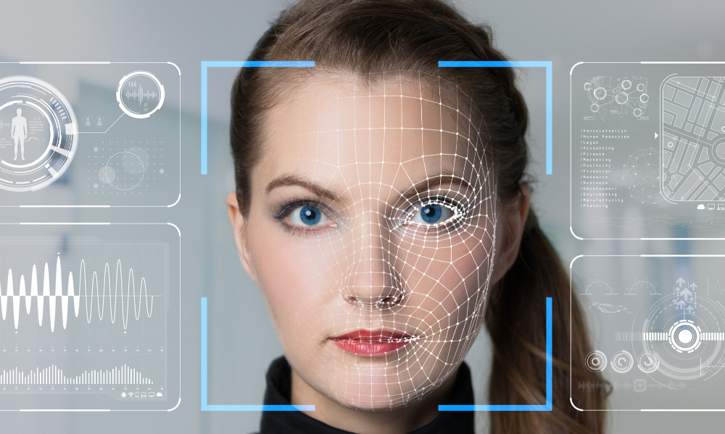

Slide 19
Comparing faces
Now that we have face embeddings for every face in our data saved in a file.
The next step is to recognize a new image that is not in our data.
So, the first step is to compute the face embedding for the image using the same network we used above.
Then compare this embedding with the rest of the embeddings we have.

Slide 20
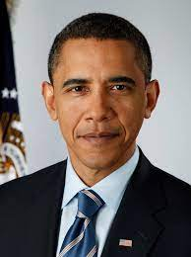
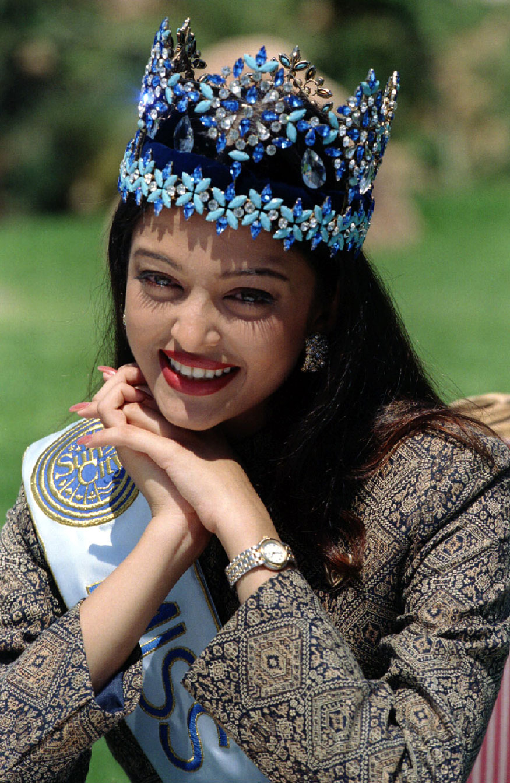

Slide 21
Face recognition
Face recognition is a method of identifying or verifying the identity of an individual using their face.
There are various algorithms that can do face recognition but their accuracy might vary.
Face Recognition is a technology in computer vision. In Face recognition/detection we locate and visualize the human faces in any digital image.
Facial recognition is used for unlocking phones and mobile apps as well as for Biometric verification.

Slide 22
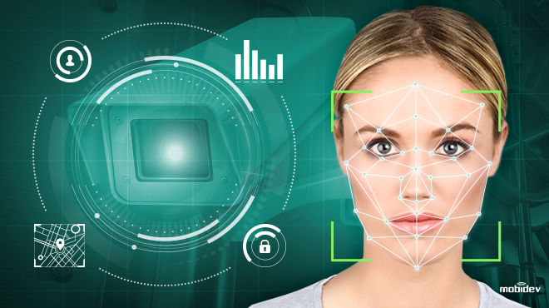
Face recognition

Slide 23
Why Python?
Python has an easy implementation for OpenCV.
Python has comparatively powerful and easy implementation.
Python comes with a huge amount of inbuilt libraries.
Less number of lines of code than other languages.
Easy to integrate.
Easy debugging.

Slide 24
Challenges and limitations:
The illumination plays an essential role during image recognition. If there is a slight change in lighting conditions, it will make major impact on its results.
The background of the object also plays a significant role in Face detection. The result might not the same outdoor as compared to what is produces indoors because the factor - affecting its performance-change as soon as the locations change.
The facial recognition system is highly sensitive to pose variations.
Occlusion means the face as beard, mustache, accessories (goggles, caps, mask, etc.) also interfere with the estimate of a face recognition system.
Change in facial expressions may produce a different result for the same individual.

Slide 25
Conclusion
In Conclusion, Computer Vision is HARD and require a big effort to start digging deep in that universe, but with Deep learning methods we can achieve state-of-the-art results on challenging computer vision problems such as image classification, object detection, and face recognition.
Despite recent progress, we are still far from solving computer vision and facial recognition. One of the simplest tech terms to define is computer vision and facial recognition. But, teaching it to computers is the most challenging task.
We’re fine-tuning computer vision and facial recognition even further with AI and deep learning.

Slide 26
Code Snippets :
The Python based program for the operation uses the following libraries and functions embedded in them.

Slide 27
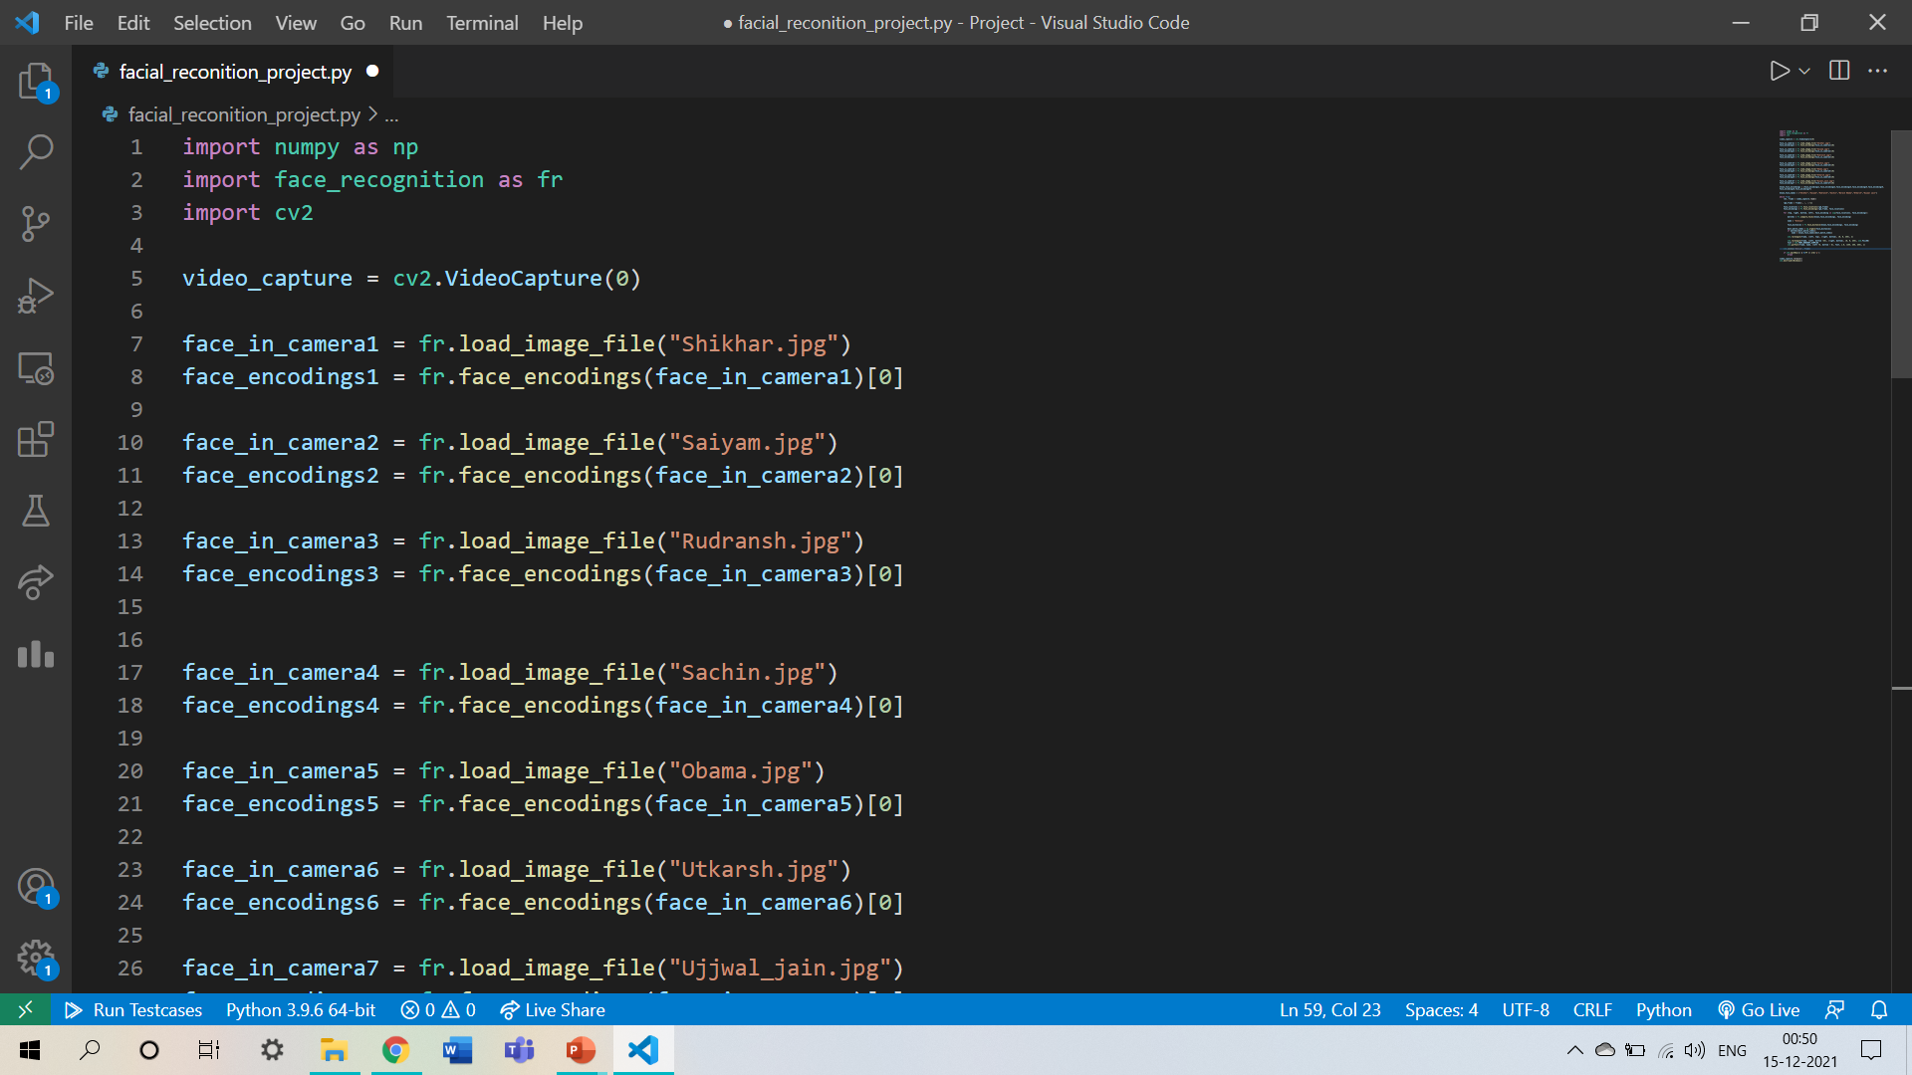

Slide 28


Slide 29
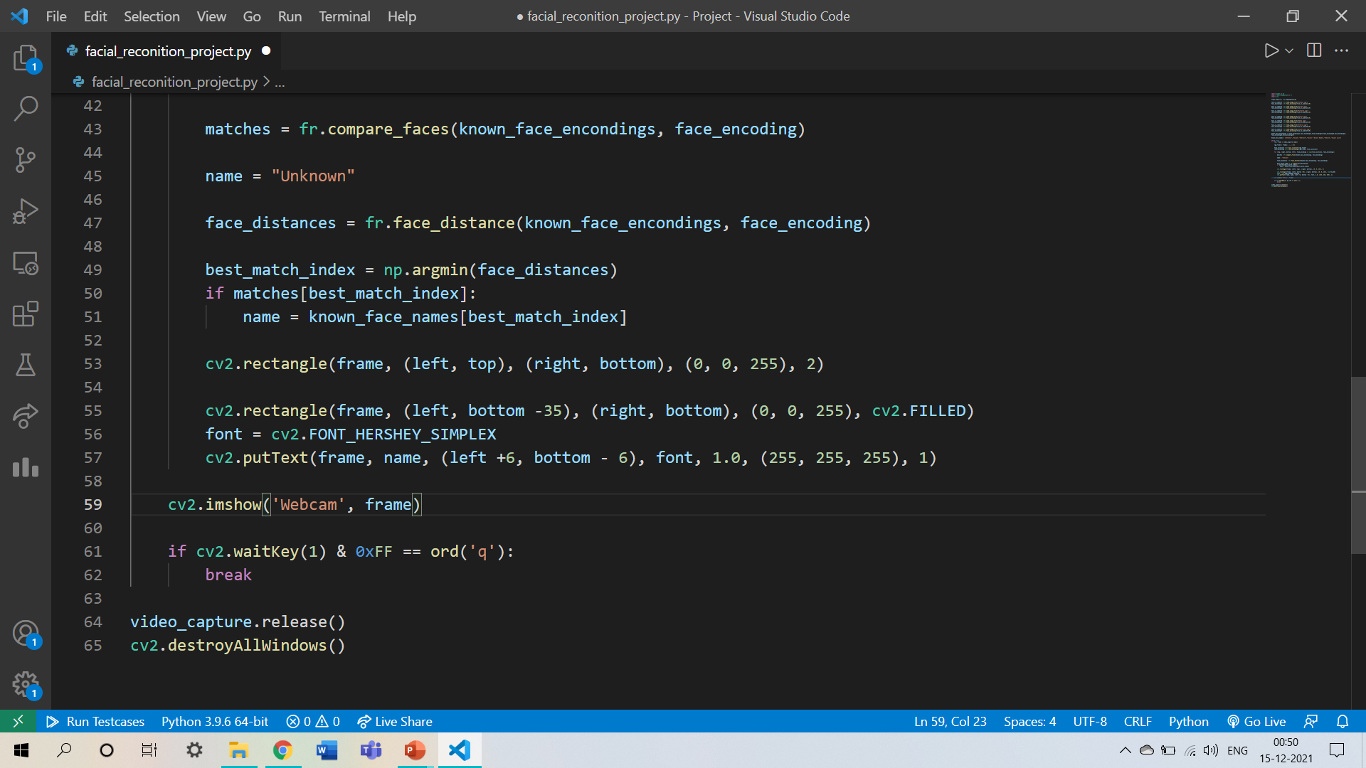

Slide 30
Output :
FOR -
Live Confrontation in the webcam as input.
Virtual Confrontation in the webcam as input.

Slide 31
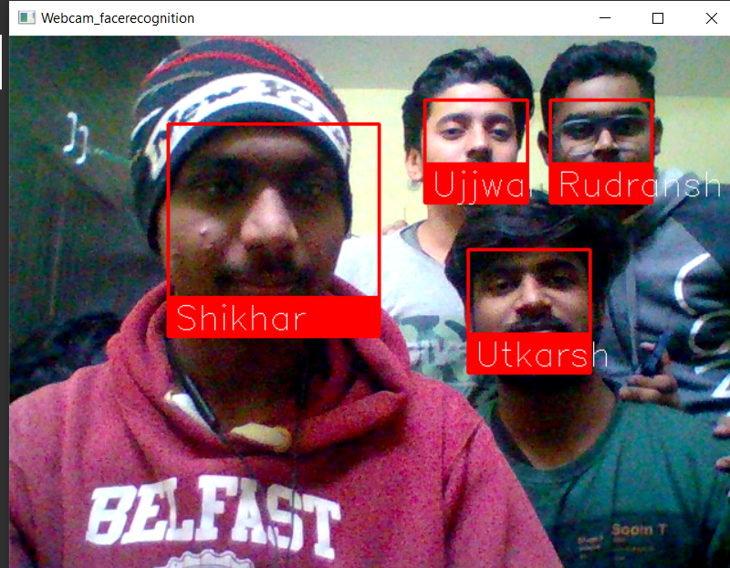
Live Confrontation :

Slide 32
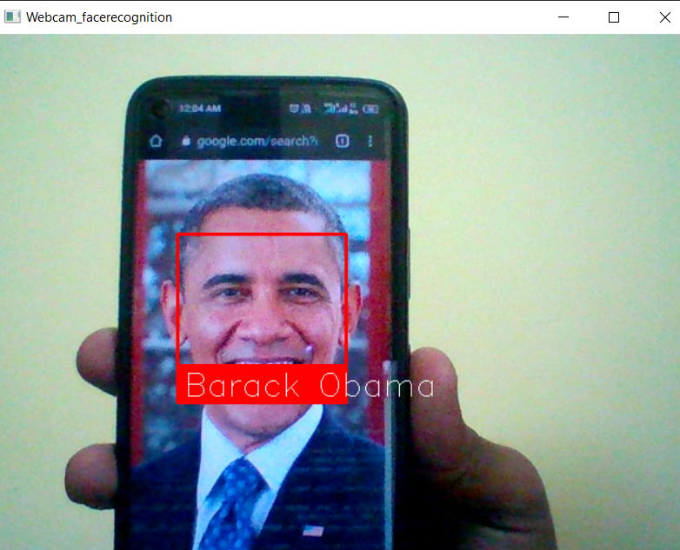
Virtual Confrontation :

Slide 33
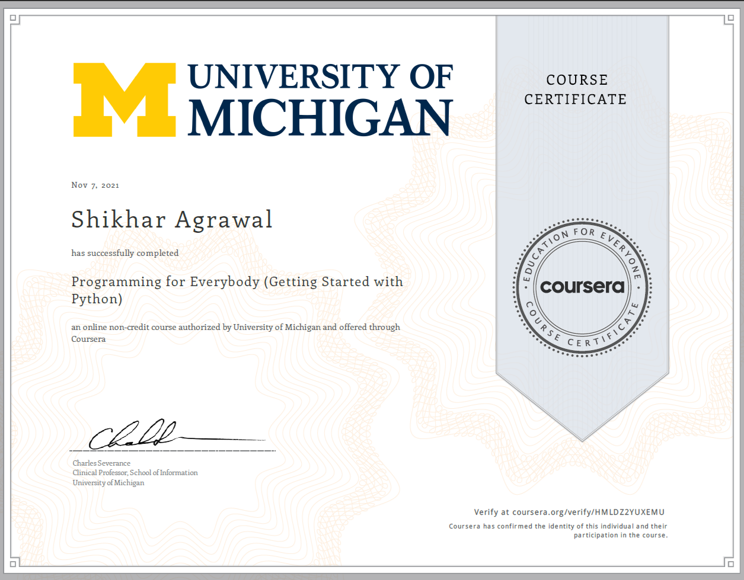
Certification

Slide 34
Thank You

